Slide 1

Employee Pay Roll

Slide 2





Project Team
Prasanna Kumar
Karan Kotian
Parth Parmar
Shivangi
Aishwarya

Slide 3

Employee Pay Roll
Result
Data Set
Payroll processes
Track employee performance
Analyze labor costs
Workforce dynamics
Clean up
Share result
EDA
Trend analysis
When scaling, group all elements to be scaled. Scale as needed. Use the “Increase Font Size,” “Decrease Font Size” buttons or manually change the font size for the editable text.

Slide 4
What motivates us to explore the Employee Payroll?
Identify trends in employee compensation
Ensure compliance with labor laws
Evaluate workforce diversity
Improve employee retention and satisfaction

Slide 5
What to explore the Employee Payroll Study dataset ?
Employee turnover
Employee performance
Salary by job title
Compensation and benefits

Slide 6
Problem statements that could be addressed using this dataset:
Identifying and addressing disparities in pay
Improving employee retention
Ensuring compliance with labor laws and regulations
Managing labor costs
Enhancing workforce diversity and inclusion

Slide 7
Who benefits from this project?
Employers can use payroll data analysis to evaluate the performance of their employees, monitor their attendance, and determine their pay rates
HR Departments: Human resources departments can use payroll data analysis to identify trends and patterns in employee performance, satisfaction, and retention
Government agencies: Government agencies can use payroll data analysis to monitor compliance with labor laws
Researchers: Researchers can use payroll data analysis to investigate labor market trends and identify patterns
Financial analysts: Financial analysts can use payroll data analysis to evaluate the financial performance of a company by examining employee costs and productivity

Slide 8
First Name
Fiscal Period
Last Name
Middle Init
Bureau
Job Title
Office Name
Categorical
Fiscal Year
Fiscal Quarter
Job Code
Position ID
Integer
Employee Payroll Data Types
Employee Identifier
Unique
Original Hiring Date
Date time
Office
Base Pay
Float

Slide 9
EDA
The first step is to examine the data to ensure it is in the correct format and structure. This may involve checking the data types, variable names, and variable formats.
Data exploration
Once the data is clean, the next step is to explore the data to understand its distribution, variance, and relationships between variables.
Data preprocessing
After exploring the data, the next step is to preprocess the data, which may involve scaling or normalizing the data, encoding categorical variables, or reducing the dimensionality of the data
Data inspection

Slide 10
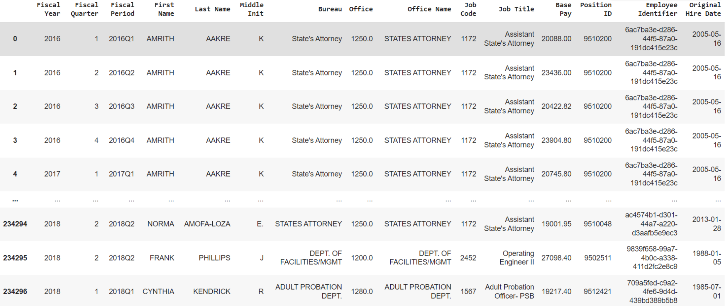
Data set

Slide 11
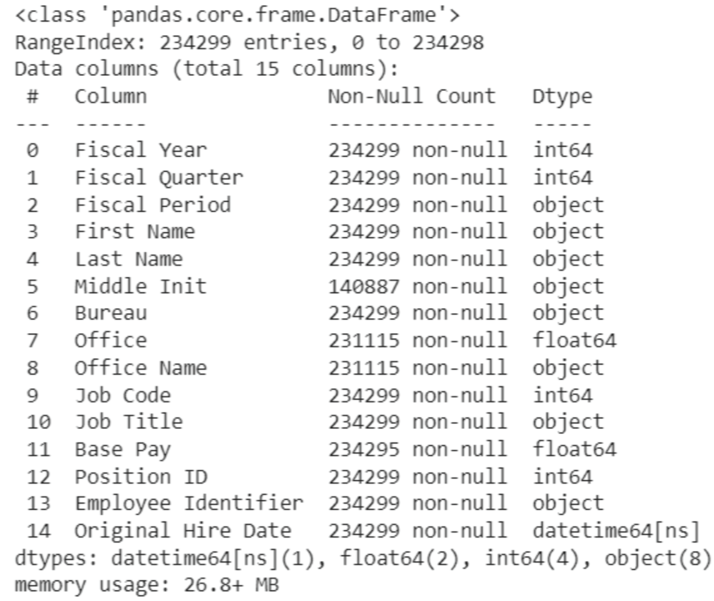

Dimension & Summary of Data
234299
15

Slide 12
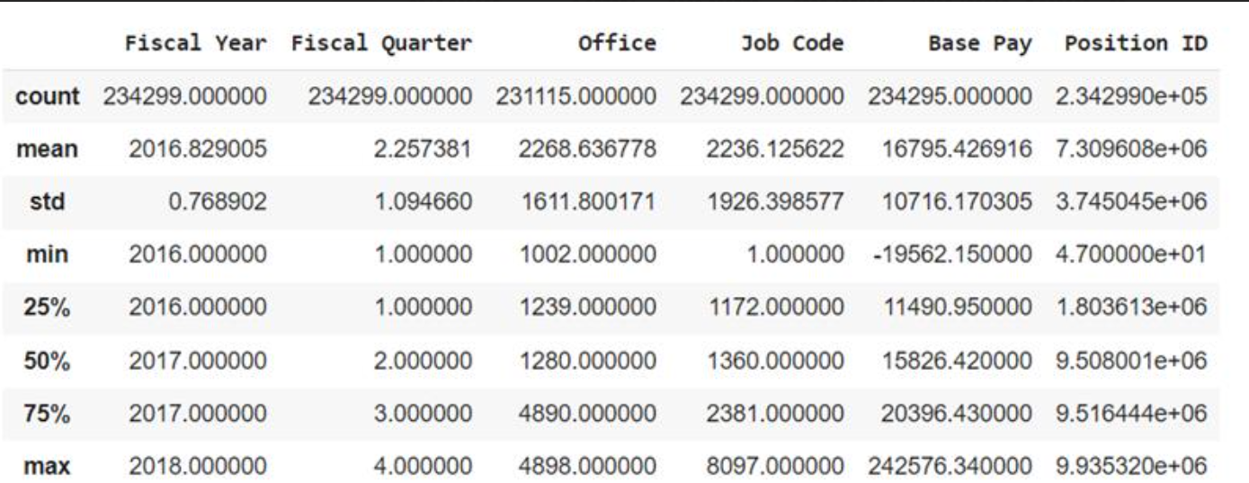
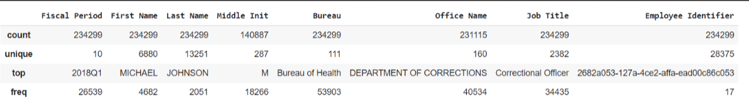
Description of Numeric & Categorical features

Slide 13
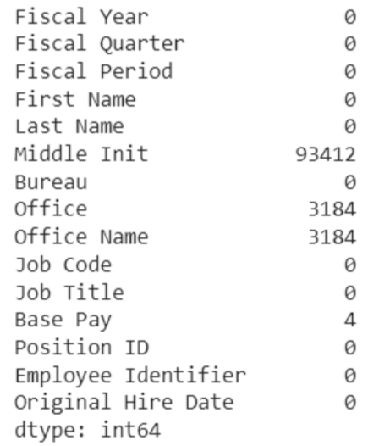
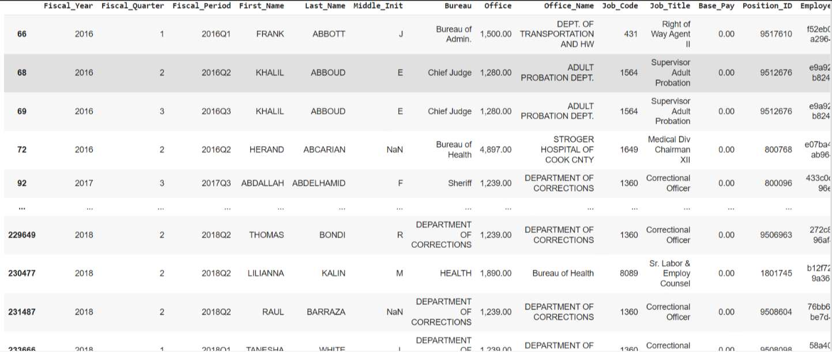
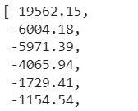
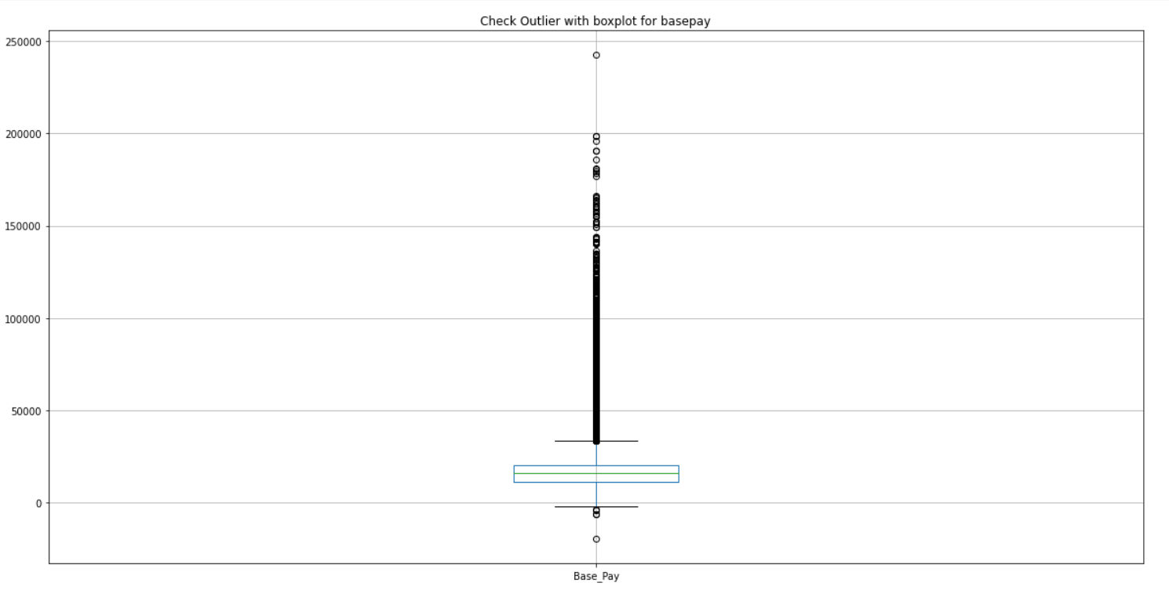
Identified errors in the data set
Null values in data set
Negative values are mentioned in Base Pay
Zero value in Base Pay
Potential outliers

Slide 14
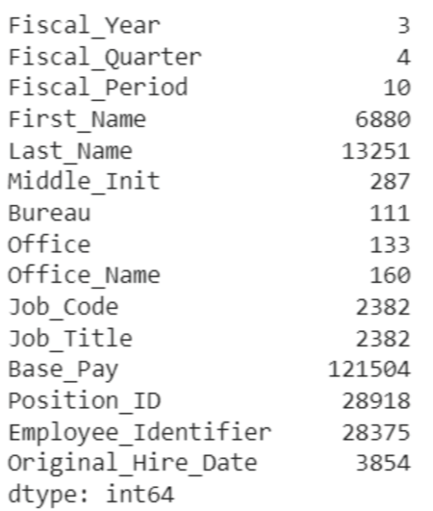
Unique Values of each feature

Slide 15
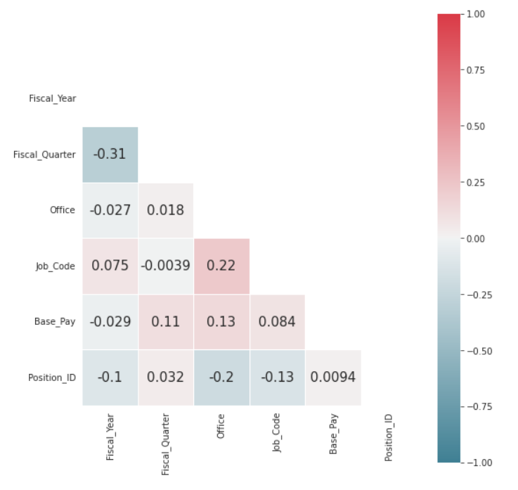
Correlation between features

